Slide 1



The edge coloring game on trees played with one more color
Mr. Fong, William Wai Lam
PhD candidate
PhD supervisor: Dr. Chan, Daricks Wai Hong
Notes:
Joint work with my PhD supervisor

Slide 2
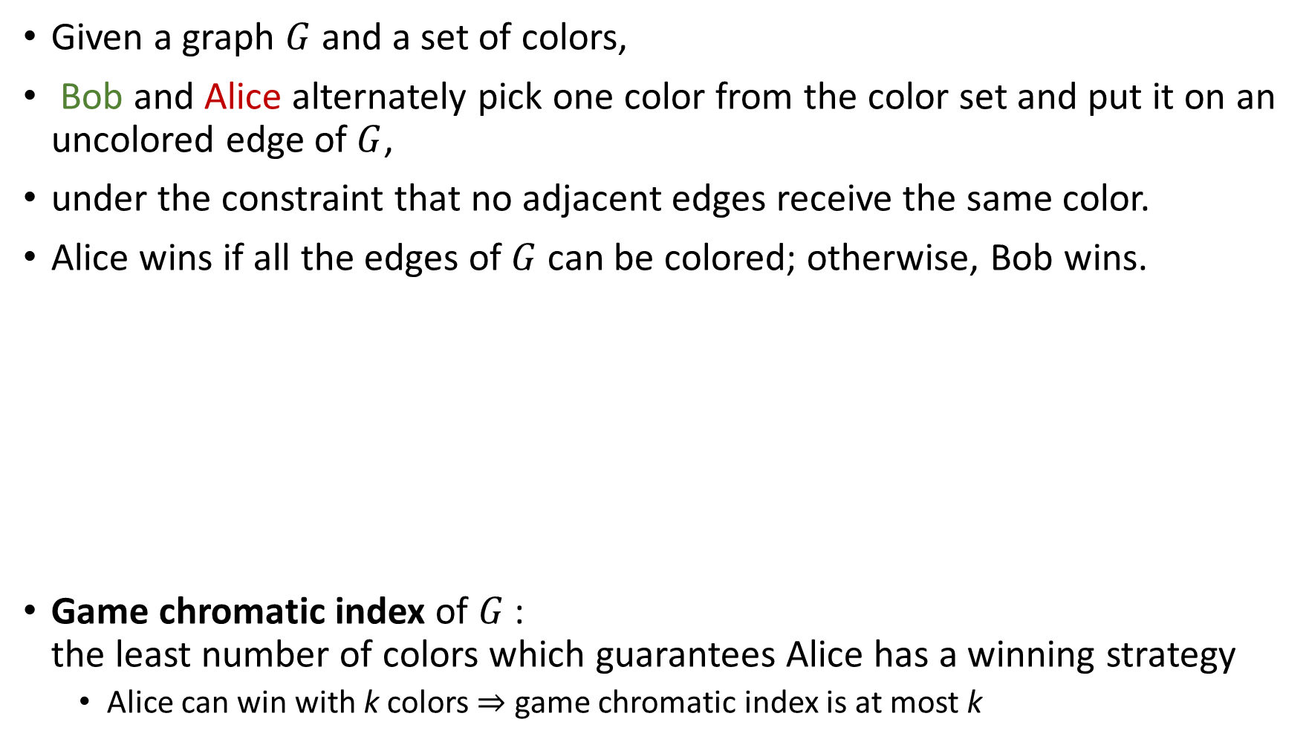

The edge coloring game
Given a graph $G$ and a set of colors,
Bob and Alice alternately pick one color from the color set and put it on an uncolored edge of $G$,
under the constraint that no adjacent edges receive the same color.
Alice wins if all the edges of $G$ can be colored; otherwise, Bob wins.
Game chromatic index of $G$:
the least number of colors which guarantees Alice has a winning strategy
  Alice can win with k colors $⇒$ game chromatic index is at most k
$$G$$
Color set ={1,2}
1
2
1
2
1
2
1
Bob wins
Alice wins
Notes:
Given a graph G and a set of colors, Bob and Alice alternately put a color on an edge, …
Let’s play on this path. Suppose Bob takes the first move, and if Alice puts 2 here, Bob can do this. Then, this edge cannot be colored by 1 nor 2, and so this edge cannot be colored, so Bob wins.
However, if Alice plays smartly, she can win. Let’s play again.
This time, Alice puts 1 here. Then the two uncolored edges can always be colored by 2. So this time, Alice wins on the same graph.
So to win the game, Alice has to play with a winning strategy. And the gchi of G is …
By this definition, if Alice can win with k colors, the index is at most k. For example, the index of this path is 2.

Slide 3
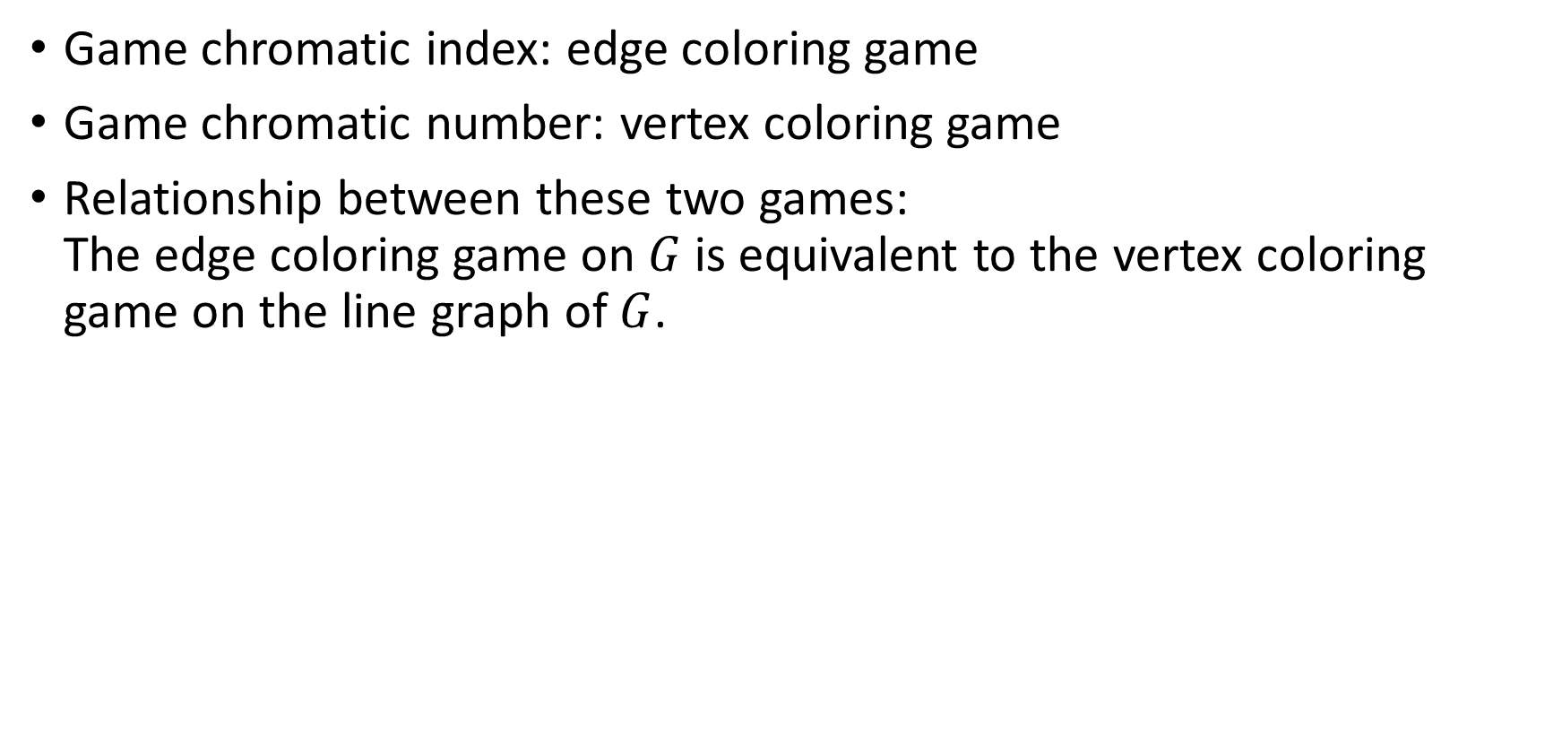

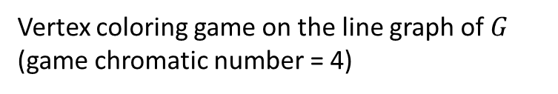
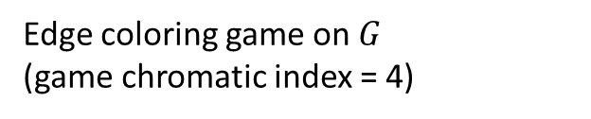
A variant: vertex coloring game
Game chromatic index: edge coloring game
Game chromatic number: vertex coloring game
Relationship between these two games:
The edge coloring game on $G$ is equivalent to the vertex coloring game on the line graph of $G$.
uv
wv
w
$$⇔$$
u
v
s
rv
sv
r
Edge coloring game on $G$
(game chromatic index = 4)
Vertex coloring game on the line graph of $G$
(game chromatic number = 4)
Notes:
The vertex coloring game will be discussed in other presentations, and here I just mention the relationship between these two games.
In the Line graph of G, vertices are the edges of G.
Equivalent …. So, the game chromatic index of this graph will be the same as the gchn of its line graph.

Slide 4
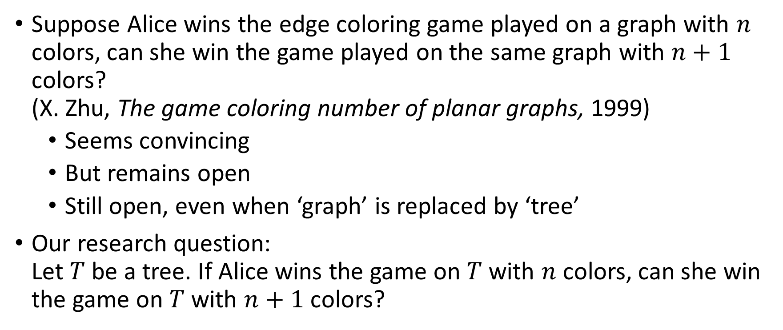
The conjecture
Suppose Alice wins the edge coloring game played on a graph with $n$ colors, can she win the game played on the same graph with $n+1$ colors?
(X. Zhu, The game coloring number of planar graphs, 1999)
  Seems convincing
  But remains open
  Still open, even when ‘graph’ is replaced by ‘tree’
Our research question:
Let $T$ be a tree. If Alice wins the game on $T$ with $n$ colors, can she win the game on $T$ with $n+1$ colors?
Notes:
Almost 2 decades ago, there was a question which is…
It seems convincing becoz in the game with n+1 colors, each edge has one more color available, so it seems it is easier to color all the edges

Slide 5
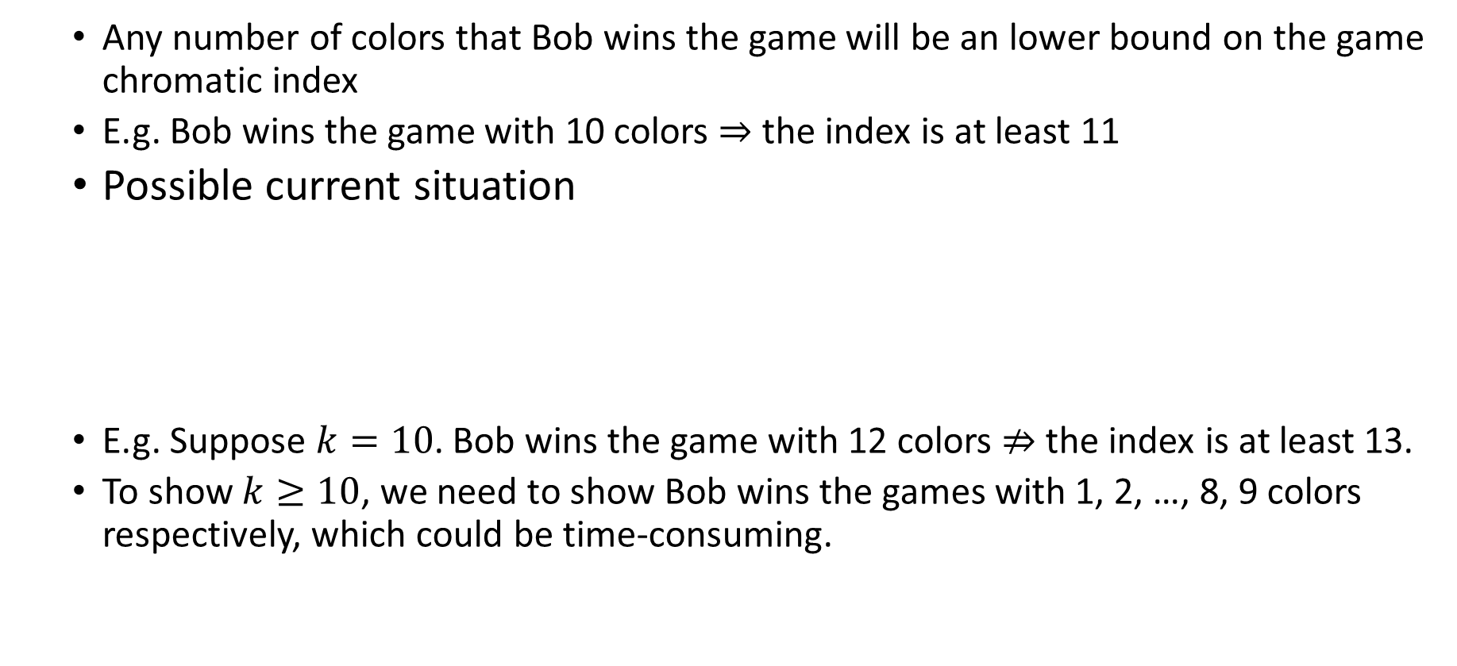
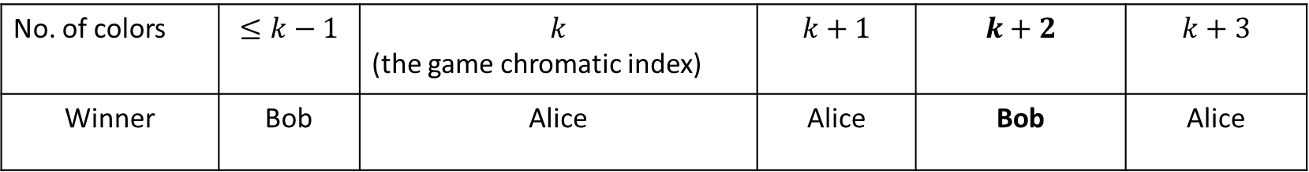
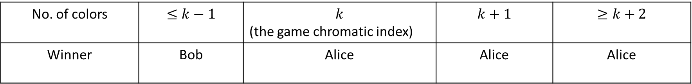
Implication of the conjecture for the index
No. of colors | $$≤k−1$$ | $$k$$ (the game chromatic index) | $$k+1$$ | $$≥k+2$$
Winner | Bob | Alice | Alice | Alice
  Any number of colors that Bob wins the game will be an lower bound on the game chromatic index
  E.g. Bob wins the game with 10 colors $⇒$ the index is at least 11
  Possible current situation
  E.g. Suppose $k=10$. Bob wins the game with 12 colors $⇏$ the index is at least 13.
  To show $k≥10$, we need to show Bob wins the games with 1, 2, …, 8, 9 colors respectively, which could be time-consuming.
No. of colors | $$≤k−1$$ | $$k$$ (the game chromatic index) | $$k+1$$ | $$k+2$$ | $$k+3$$
Winner | Bob | Alice | Alice | Bob | Alice
Notes:
(start at k) by the definition of the game chromatic index, A wins the game played with k colors.
Suppose the conjecture is true, she also wins for k+1 colors. And we can use this property repeatedly, she wins for all no. of colors larger than k+1
As the game chromatic index is the least no. of colors that Alice can win, she loses for all no. of colors less than k.
So we have this table if the conjecture is true. It means any number of colors that Bob wins the game will be an lb on the index.
If we dun know the conjecture is true or false, then a possible situation is this one.
e.g. …
To show the index is at least 10, by the definition of the index, we need to show Bob wins for all games with number of colors less than 10, which could be time consuming.
So, the conjecture is useful for finding an lb on the index.

Slide 6
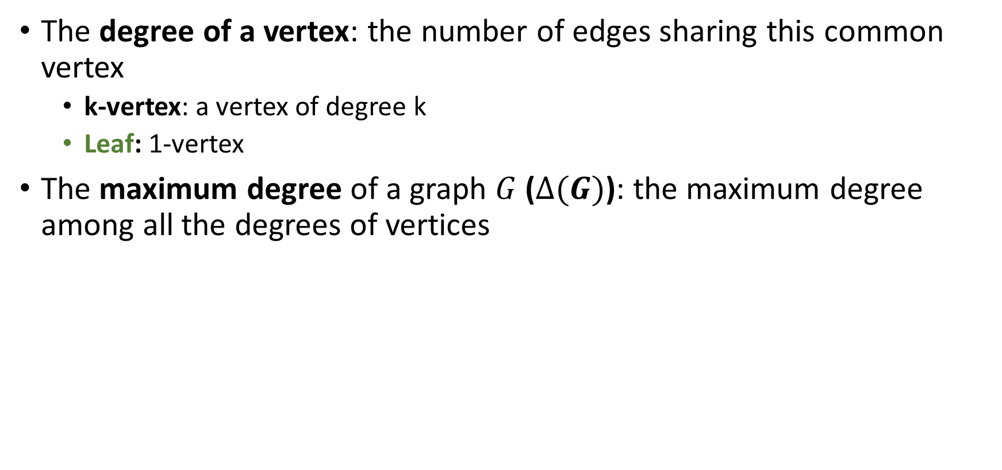

Terminology
The degree of a vertex: the number of edges sharing this common vertex
  k-vertex: a vertex of degree k
  Leaf: 1-vertex
The maximum degree of a graph $G$ ($∆(G)$): the maximum degree among all the degrees of vertices
w
Vertex | Degree of vertex
u | 1
w | 1
v | 4
r | 1
s | 1
$∆\left(G\right)=4$
u
v
s
r
Graph G
Notes:
In this example, we have 4 leaves and v is a 4-vertex becoz it is shared by 4 edges. And delta(G) is 4.

Slide 7

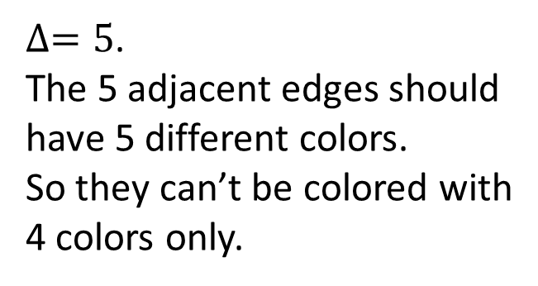
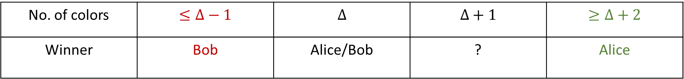
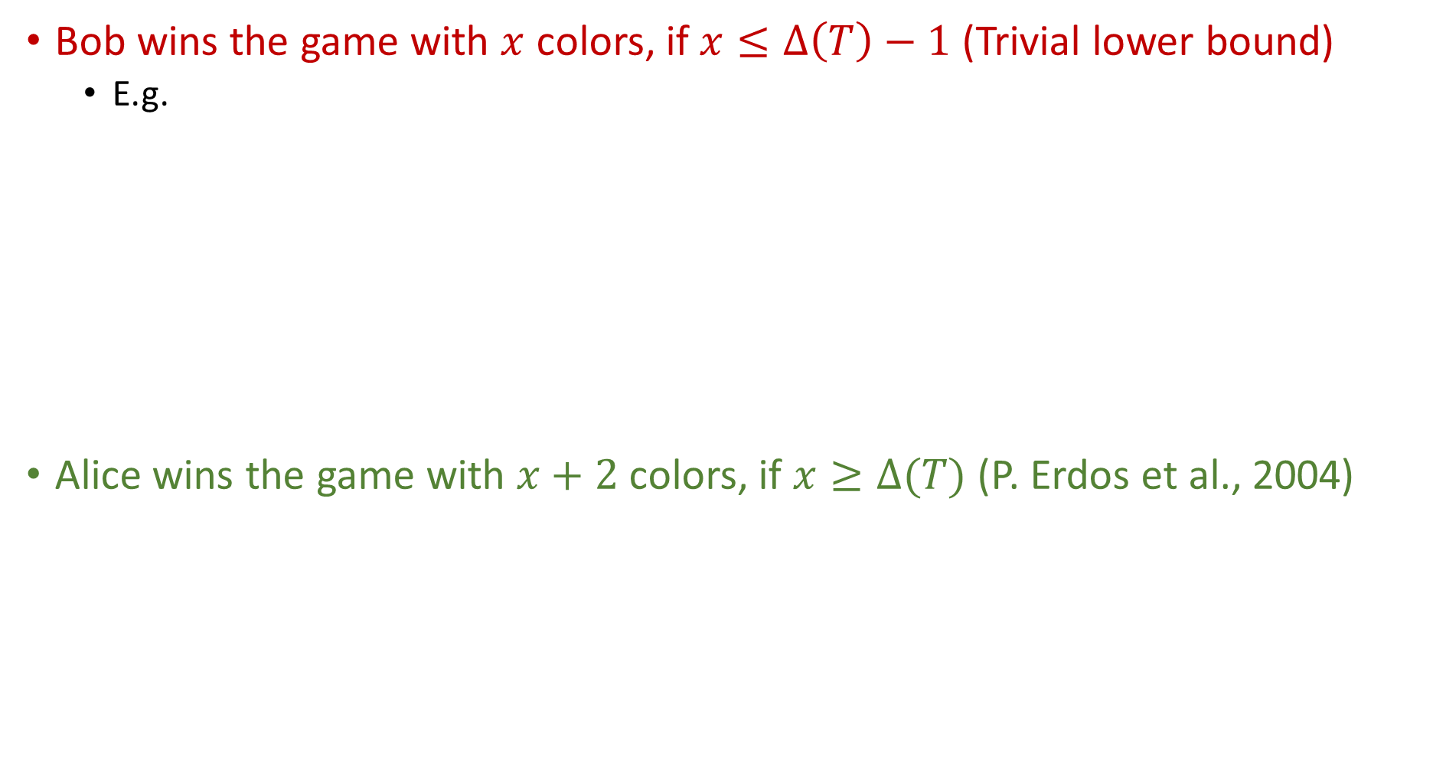
Previous results about the edge coloring game on trees $T$
Bob wins the game with $x$ colors, if $x≤∆\left(T\right)−1$ (Trivial lower bound)
  E.g.
Alice wins the game with $x+2$ colors, if $x≥∆(T)$ (P. Erdos et al., 2004)
$∆=5$.
The 5 adjacent edges should have 5 different colors.
So they can’t be colored with 4 colors only.
1
5
2
4
3
No. of colors | $$≤∆−1$$ | $$∆$$ | $$∆+1$$ | $$≥∆+2$$
Winner | Bob | Alice/Bob | ? | Alice
Notes:
Trivial lower bound: For a vertex with deg=$∆$, there are $∆$ adjacent edges and they must have different colors if all of them can be colored.

Slide 8
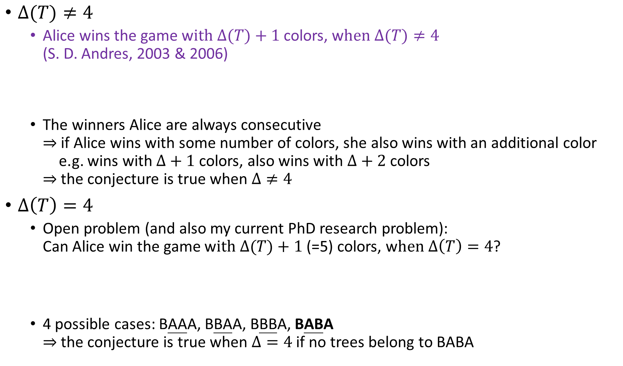
$∆(T)≠4$
  Alice wins the game w$ith ∆(T)+1$ colors, w$hen Δ(T)≠4$
  (S. D. Andres, 2003 & 2006)
  The winners Alice are always consecutive
  $⇒$ if Alice wins with some number of colors, she also wins with an additional color
  e.g. wins with $∆+1$ colors, also wins with $∆+2$ colors
  $⇒$ the conjecture is true when $Δ≠4$
$∆\left(T\right)=4$
  Open problem (and also my current PhD research problem):
  Can Alice win the game w$ith ∆(T)+1$ (=5) colors, w$hen Δ\left(T\right)=4$?
  4 possible cases: BAAA, BBAA, BBBA, BABA
  $⇒$the conjecture is true when $Δ=4$ if no trees belong to BABA
No. of colors | $$≤∆−1$$ | $$∆$$ | $$∆+1$$ | $$≥∆+2$$
Winner | Bob | Alice/Bob | Alice | Alice
No. of colors | $$≤3$$ | $$4$$ | $$5$$ | $$≥6$$
Winner | Bob | Alice/Bob | Alice/Bob | Alice
Notes:
For $∆$ not equal to 4, thanks to Dr. Stephan Andres, who will also give a presentation, he proved that …
wins with $∆$+2, also wins with $∆$+3
This time, we dun have
When $Δ=4$, unfortunately, we dun have this result (purple). In other words, it is an open problem that whether Alice can win the game with 5 colors, when $∆$=4. So, the winner for the game with 5 colors is uncertain.
Because these 2 are uncertain, we have 4 possible cases
Because Alice are consecutive in the first 3 cases

Slide 9
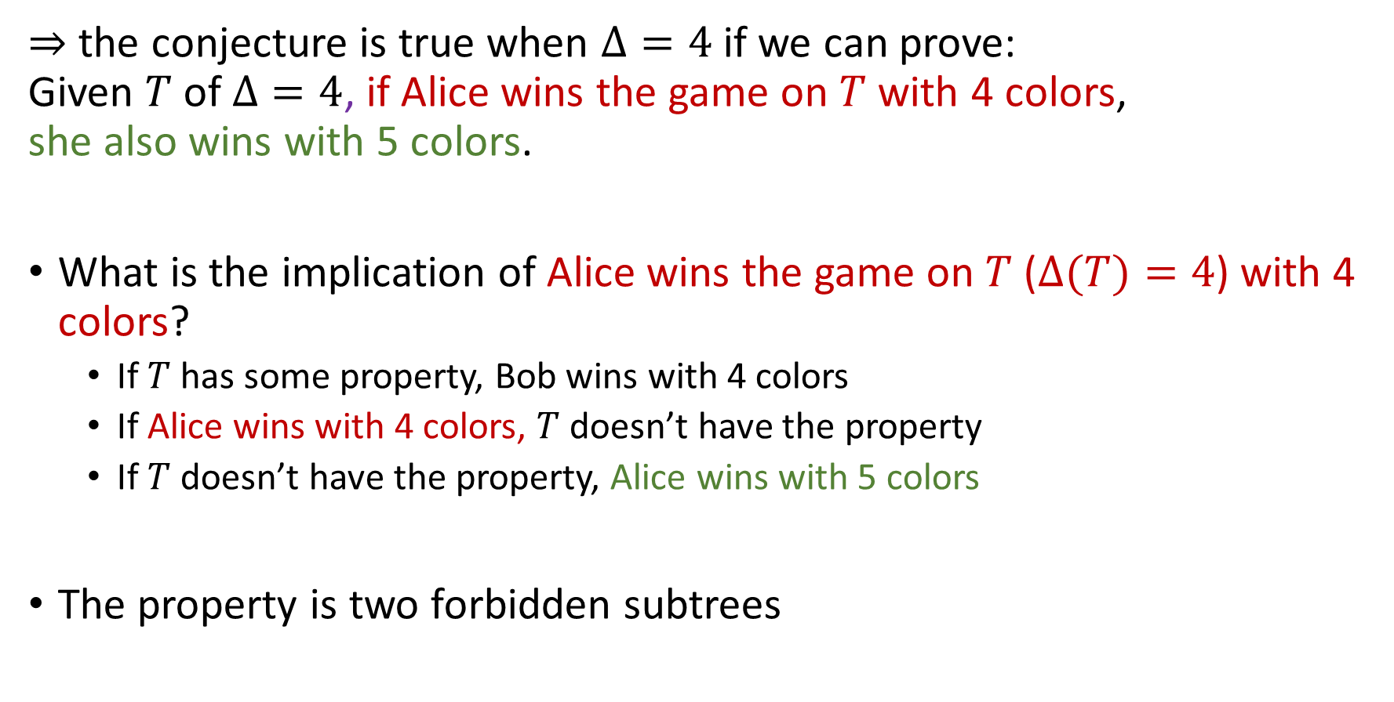
$⇒$ the conjecture is true when $Δ=4$ if we can prove:
Given $T$ of $Δ=4$, if Alice wins the game on $T$ with 4 colors,
she also wins with 5 colors.
What is the implication of Alice wins the game on $T$ ($Δ(T)=4$) with 4 colors?
  If $T$ has some property, Bob wins with 4 colors
  If Alice wins with 4 colors, $T$ doesn’t have the property
  If $T$ doesn’t have the property, Alice wins with 5 colors
The property is two forbidden subtrees
Notes:
We want to know the implication of the assumption.
Suppose we can show if T has some property, Bob wins with 4 colors. Then using contrapositive, …
And we are done, if we can prove if T doesn’t have the property, Alice wins with 5 colors.

Slide 10
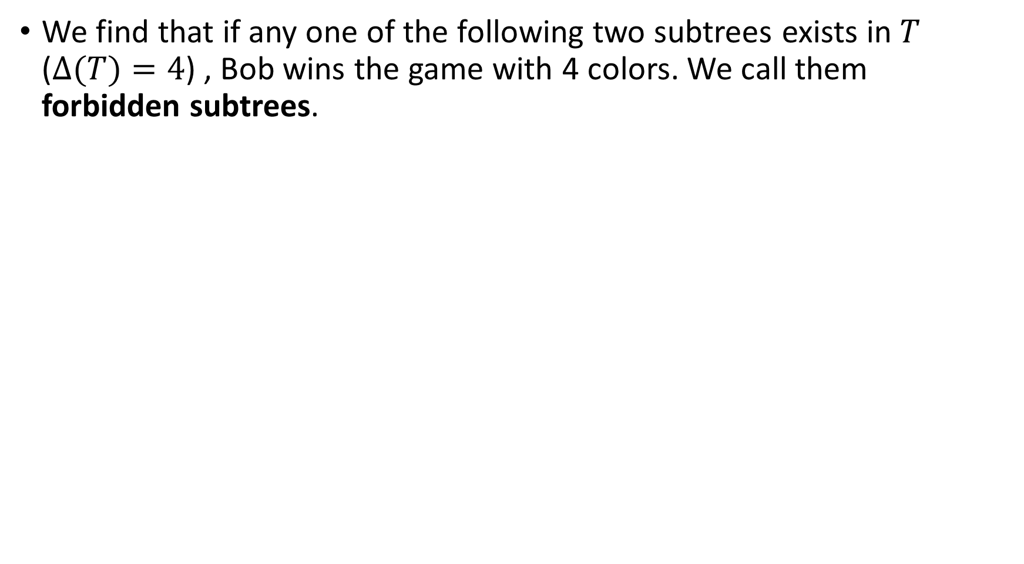
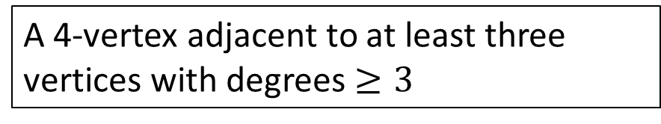

Two forbidden subtrees
We find that if any one of the following two subtrees exists in $T$ ($Δ(T)=4$) , Bob wins the game with 4 colors. We call them forbidden subtrees.
A 4-vertex adjacent to at least three vertices with degrees $≥3$
Three adjacent 4-vertices and the middle one is not adjacent to two leaves
: 4-vertex
: vertex with degree $≥3$
Notes:
More accurately, we find that …
While the red one is a 4-vertex, the orange is a vertex with degree not less than 3.

Slide 11

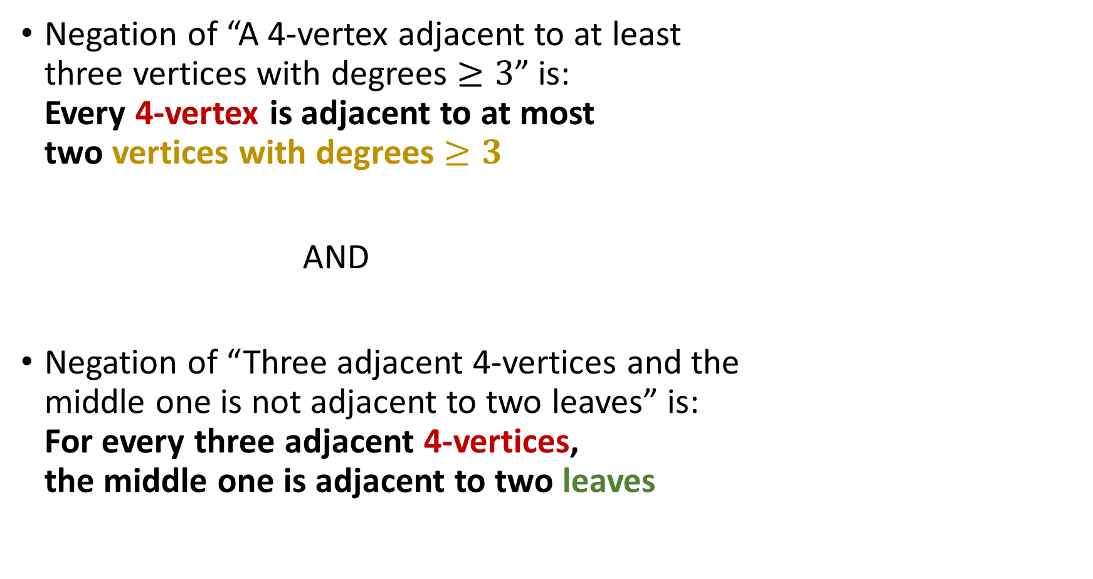
If Alice wins the game on $T$ with 4 colors
Negation of “A 4-vertex adjacent to at least
three vertices with degrees $≥3$” is:
Every 4-vertex is adjacent to at most
two vertices with degrees $≥3$
AND
Negation of “Three adjacent 4-vertices and the
middle one is not adjacent to two leaves” is:
For every three adjacent 4-vertices,
the middle one is adjacent to two leaves
Leaf
Notes:
So, using contrapositive, if Alice wins the game with 4 colors, …
For example, it is of deg 3 and it is of deg 4.
Now I show an example of their union

Slide 12
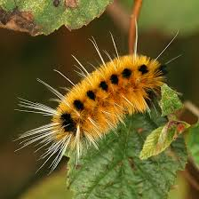
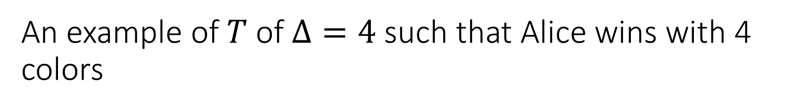
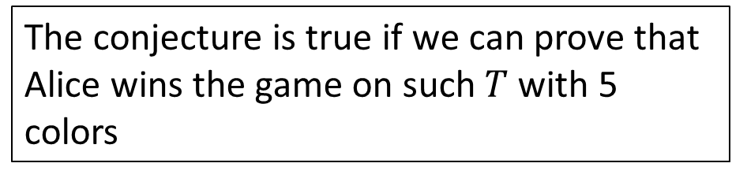
An example of $T$ of $Δ=4$ such that Alice wins with 4 colors
Leaf
The conjecture is true if we can prove that Alice wins the game on such $T$ with 5 colors
Caterpillar
Notes:
First, it can have 2 adjacent 4 vertices, and we know how to deal with
Second, it can have a long path of 4 vertices, if the internal vertices are all adjacent to 2 leaves. And in fact we have known Alice can win with 5 colors on caterpillars.

Slide 13
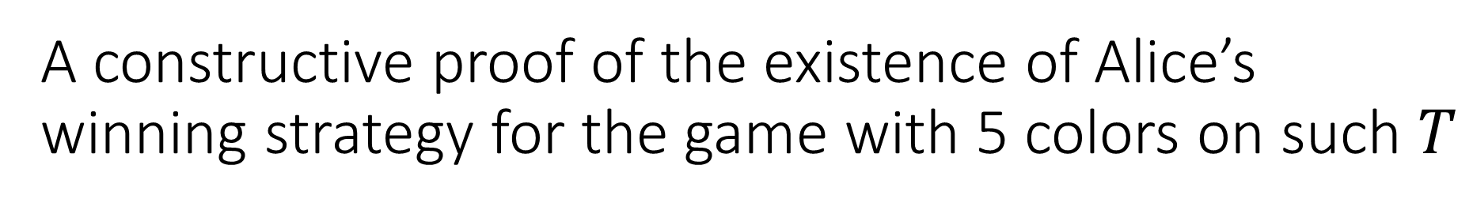
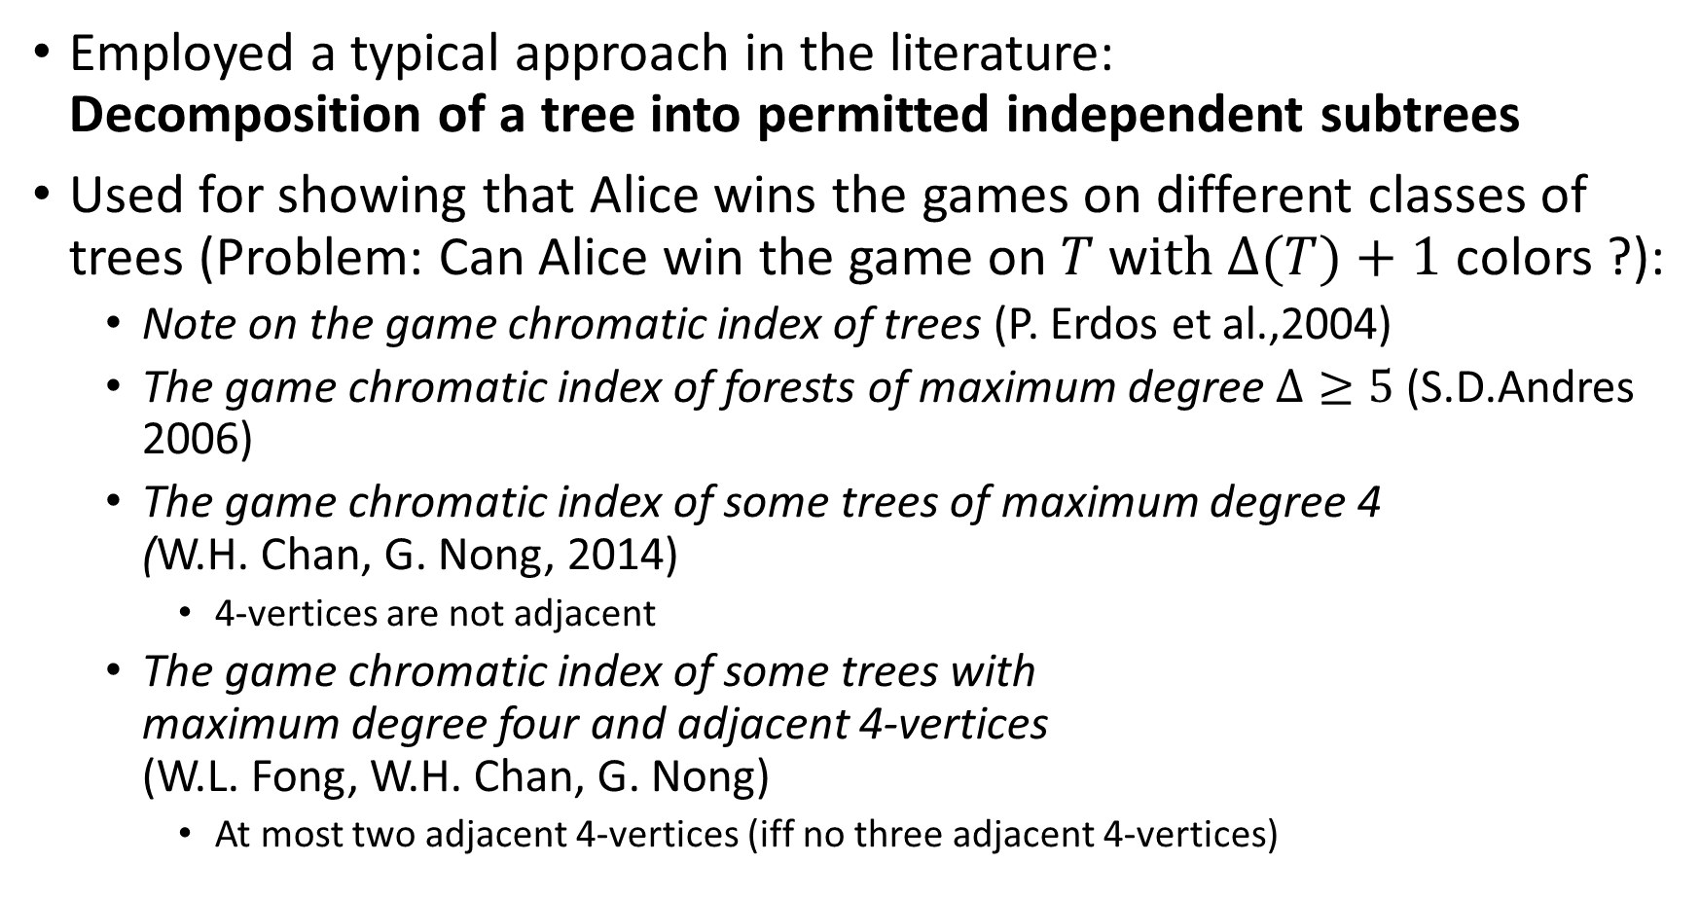
A constructive proof of the existence of Alice’s winning strategy for the game with 5 colors on such $T$
Employed a typical approach in the literature:
Decomposition of a tree into permitted independent subtrees
Used for showing that Alice wins the games on different classes of trees (Problem: Can Alice win the game on $T$ w$ith ∆(T)+1$ colors ?):
  Note on the game chromatic index of trees (P. Erdos et al.,2004)
  The game chromatic index of forests of maximum degree $Δ≥5$ (S.D.Andres 2006)
  The game chromatic index of some trees of maximum degree 4
  (W.H. Chan, G. Nong, 2014)
    4-vertices are not adjacent
  The game chromatic index of some trees with
  maximum degree four and adjacent 4-vertices
  (W.L. Fong, W.H. Chan, G. Nong)
    At most two adjacent 4-vertices (iff no three adjacent 4-vertices)
Notes:
This approach is used for showing that Alice wins the games on different classes of trees. In fact, all of them deals with the open problem that I mentioned before.
The first two were mentioned before. And after the second one, only the case that $Δ$=4 is left. Then, my supervisor Daricks Chan showed that if 4-vertices are not adjacent. Recently, our team shows that it is still true when 4-vertices are adjacent, given that there are at most two adjacent 4-vertices, in other words, no three adjacent 4-vertices.
For those who are interested in this problem, here is the current progress.

Slide 14
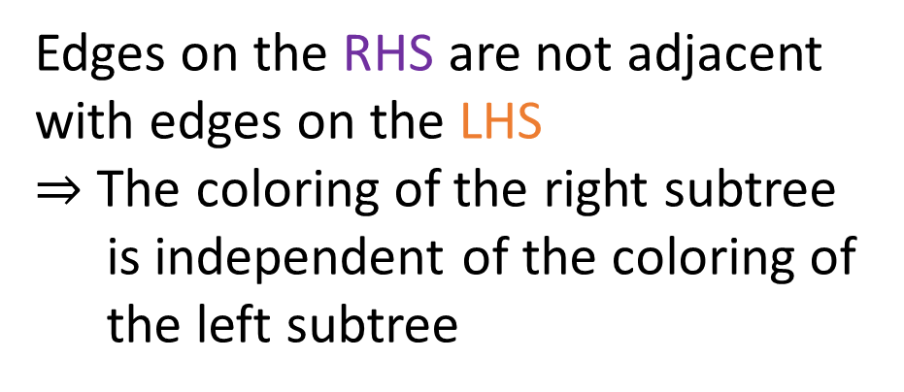
Decomposition of a tree into independent subtrees
Edges on the RHS are not adjacent with edges on the LHS
$⇒$ The coloring of the right subtree is independent of the coloring of the left subtree
2
1
3
e
Split into 2
2
T₁ and T₂ are independent subtrees (subtree)
1
3
3
e
e
T₁
T₂
Notes:
Suppose we have a partially colored tree. Now, a player is going to color this edge e.(click)
After this coloring, because it is a tree, edges on the right side must not be adjacent with edges on the left side.
Therefore, the coloring of the right is independent of the coloring of the left.
So, we can consider them separately (click) and call them independent subtrees, or in short, subtree only.
We remark that the just colored edge, which is the bridge connecting the Left and Right, is duplicated and contained in both subtrees, so that we don’t miss any information for their colorings.

Slide 15
Permitted subtree
Properties
  Alice can decompose it into 2 permitted subtrees
  When Bob decomposes it into 2 subtrees, at most one is unpermitted
  Alice can decompose this unpermitted subtree into 2 permitted subtrees
Example
  A type of permitted subtrees: subtrees with at most 3 colored edges
3
1
4
3
1
1
4
2
By Alice
1
4
2
Notes:
Then, we can define a class of permitted subtrees. And each permitted subtree has the following 3 properties:…It looks complex so let’s have an example.
Suppose we have a type of permitted subtrees defined as subtrees having at most 3 colored edges, for example, this one.
If Bob puts 1 here, we have 4 colored edges which is unpermitted. Then, Alice can do this to split it into 2 subtrees so that each of them has 3 colored edges, which is permitted.
Using the idea of this example (next page)

Slide 16
With the three properties, Alice can maintain the following cycle and will win:
Bob’s turn
T₁ (permitted type 2)
T₂ (permitted type 3)
Other permitted subtrees of different types
A cycle so that Bob can only act on permitted subtrees
Alice’s turn
T₃ (permitted type 1)
T₄ (unpermitted/permitted)
(by property 2)
Bob’s next turn
Other permitted subtrees of different types
T₁
T₅ (permitted type 2)
T₆ (permitted
type 4)
T₃
(by property 1&3)
Alice’s next turn
…
(finitely many times)
Recall the three properties of permitted subtrees:
  Alice can decompose it into 2 permitted subtrees
  When Bob decomposes it into 2 subtrees, at most one is unpermitted
  Alice can decompose this unpermitted subtree into 2 permitted subtrees
Notes:
Using the spirit of the example, we can show Alice can maintain the following cycle
Suppose, at some Bob’s turn, if all the subtrees are permitted, which could be of different types. He can choose any one to color, say T2. T2 will become two subtrees T3 and T4; one must be permitted and the other is unknown. Alice then decompose this unknown one into two permitted subtrees.
So, at Bob’s next turn, all subtrees are permitted, which is the same as his previous turn, and we call this is a cycle so that Bob can only act on permitted subtrees. This makes sure that A and B can always make a move, and becoz there are finitely many edges in a graph, all the edges will finally be colored and Alice will win.
This is the framework of the proof. The rest of the proof is some technical stuff such as the definition of a few types of permitted subtrees, and how these types can satisfy these three properties. So I will skip them.

Slide 17
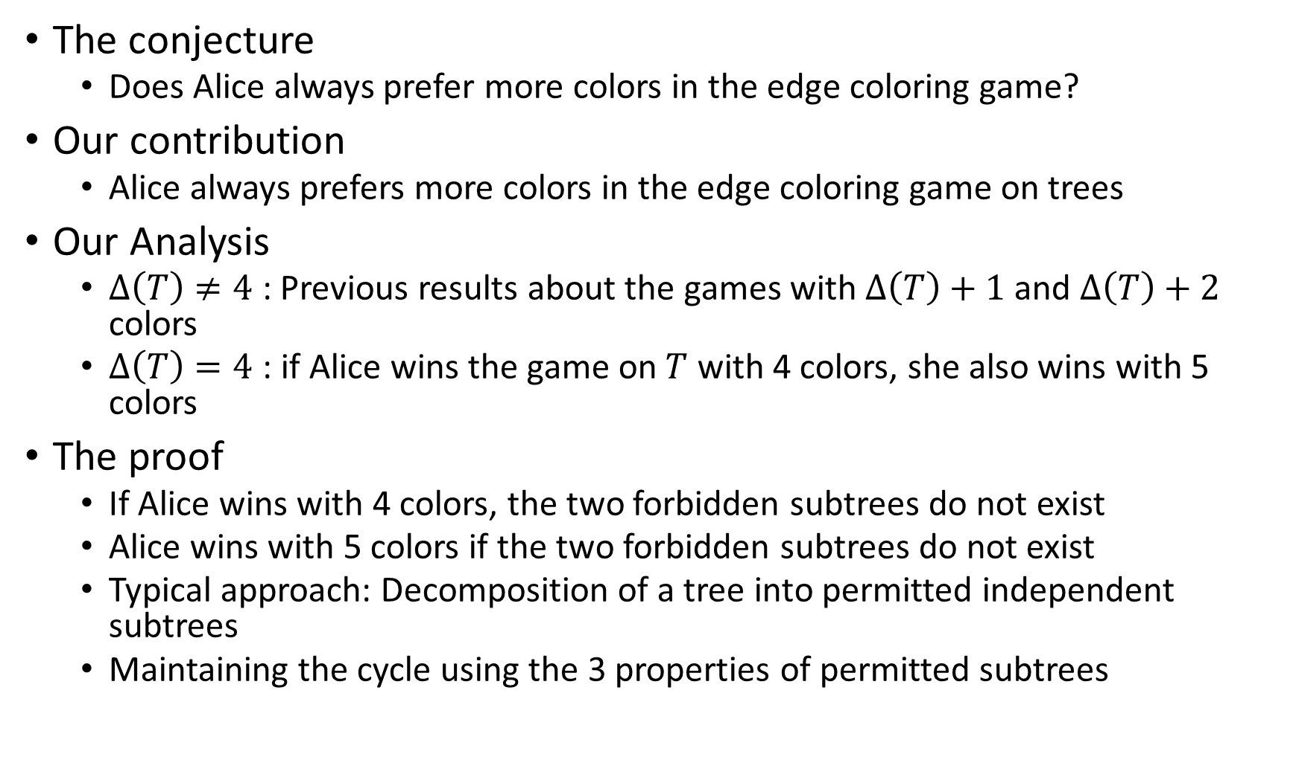
Recap: The edge coloring game on trees played with one more color
The conjecture
  Does Alice always prefer more colors in the edge coloring game?
Our contribution
  Alice always prefers more colors in the edge coloring game on trees
Our Analysis
  $∆\left(T\right)≠4$: Previous results about the games with $∆\left(T\right)+1$ and $∆\left(T\right)+2$ colors
  $∆\left(T\right)=4$ : if Alice wins the game on $T$ with 4 colors, she also wins with 5 colors
The proof
  If Alice wins with 4 colors, the two forbidden subtrees do not exist
  Alice wins with 5 colors if the two forbidden subtrees do not exist
  Typical approach: Decomposition of a tree into permitted independent subtrees
  Maintaining the cycle using the 3 properties of permitted subtrees
Notes:
In this talk, we consider a conjecture which is whether Alice
And our answer is yes, she prefers more colors in the game on trees
In our analysis, we decompose the problem into two parts, max deg not equal to 4 and when it is 4.

